Slide 1
Ames House Price Prediction
Prepared by : Arti Jariwala
Date: 8th MARCH 2021

Slide 2
Content Page
Problem Statement
Datasets
The Process
Missing Data
Exploratory Visualizations
Outliers Were Removed
Linearity & Correlations
Data Modelling & Evaluation
Lasso for Feature Selection
Building Models
Residuals
Conclusions & Recommendations

Slide 3
Problem Statement
The aim of this project is to create and evaluate regression model for predicting the price of a house in Ames city at the time of sale.
We also would like to get a better understanding of the features which has prominent impact in increase or decrease of the sale price.

Slide 4
Datasets
Provided with 2 datasets :Train and Test
Train contains 2051 rows and 81 columns representing all the features of a house along with their sale price
Test contains 879 rows and 80 columns representing all the features of a house.
Type of data in both the datasets:
Numeric – lot area, gr_liv_area, etc
Ordinal – overall_qual, basement condition, etc
Nominal/Categorical – neighborhood, garage type, etc

Slide 5
The Process
Understanding Data
Data Cleaning
Exploratory Visualizations
Feature Engineering & Preprocessing
Data Modelling & Evaluation

Slide 6
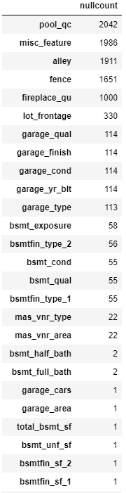
Missing Data
Several missing data were found using different technique.
Feature missing – Replace null with either NA or 0 according to their type.
Feature present but missing value – Replace the null with either median or mode value.

Slide 7
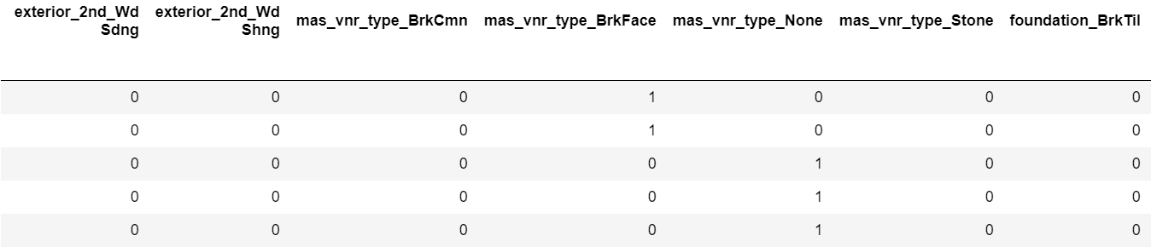
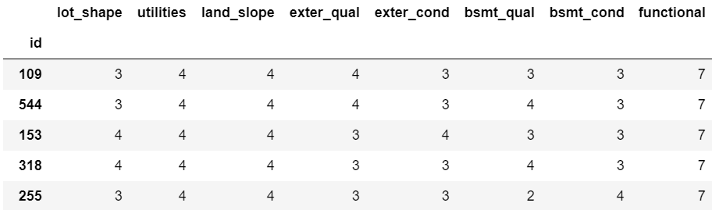
Ordinal & Nominal Fields
Ordinal fields were replaced by their numeric ranking
Nominal fields were encoded using dummy fields

Slide 8
Exploratory Visualizations

Slide 9
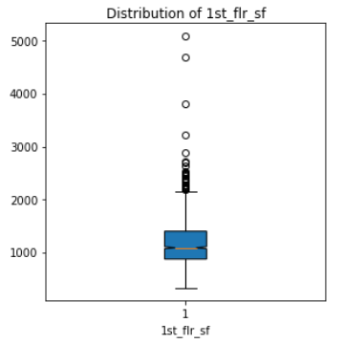
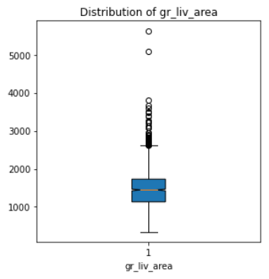
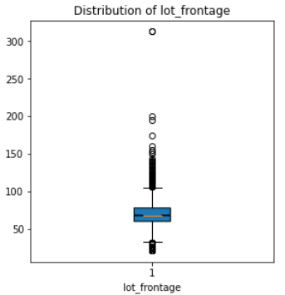
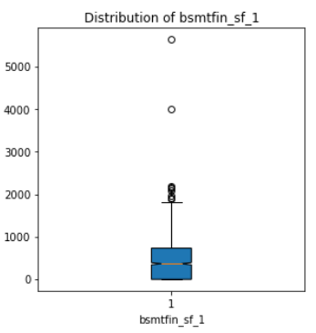
Outliers Were Removed
Outliers were removed using boxplot graphs.
Correlation improved with sale price after removing outliers.

Slide 10
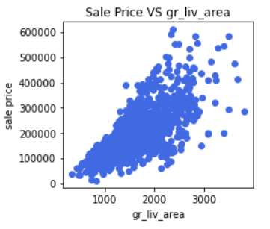
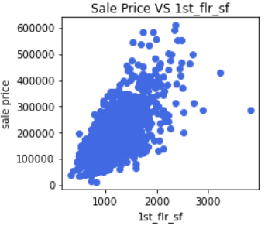
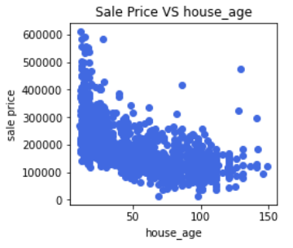
Linearity & Correlation
House Age was added using built year for better interpretation.
We can see that ground living area and 1st floor sq ft have positive linear relation whereas house age has negative linear relation with sale price.
They also have high correlation with sale price.
Other correlated overall quality, exterior quality, total basement sq ft, garage area, etc are also highly correlated to sale price.
Multi collinearity was also considered.

Slide 11
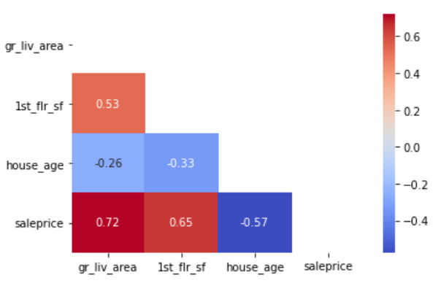
Linearity & Correlation

Slide 12
Data Modelling & Evaluation

Slide 13
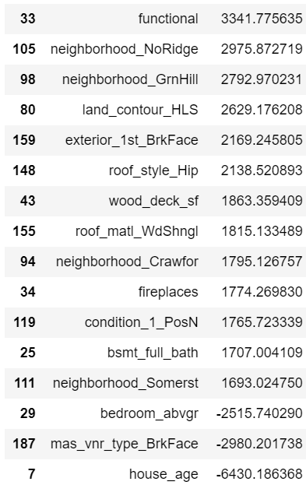
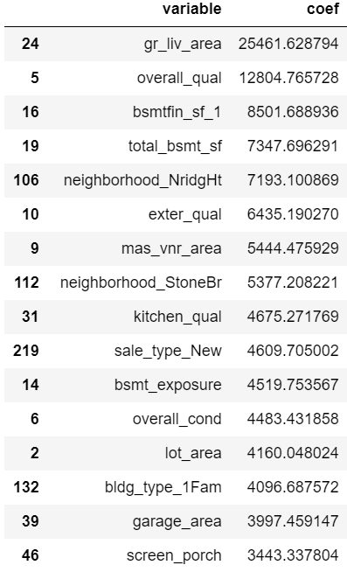
Lasso for Feature Selection
Lasso regression was used for feature selection.
Following 30 features were selected for further model evaluation.

Slide 14
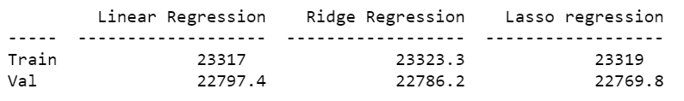

Building Models
Linear Regression
Ridge Regression
Lasso Regression
After evaluation Lasso regression model was selected as it had lowest RMSE.

Slide 15
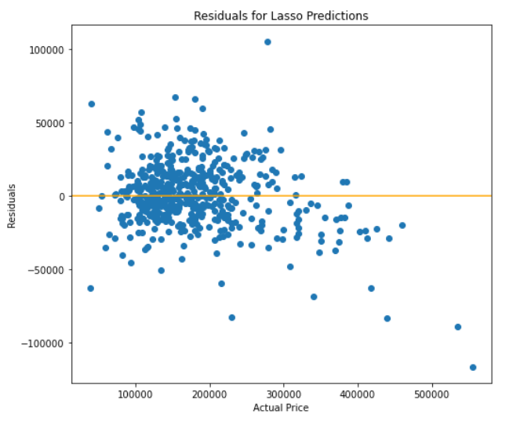
Residuals
Comparison between actual and residuals.
The model best predicts the prices between $80000 to $250000.

Slide 16
Conclusions & Recommendations
Based on the analysis following are the features that have greater impact on increase of the sale price:
Ground Liv Area
Overall material finish and quality of the house
Exterior quality and condition
Newly constructed house
Neighborhoods: Northridge Heights, Stone Brook
Basement Area
Land Area
Kitchen quality
However, one of the main reason that was noticed for price drop is age of the house. As the age of the house increases, price decreases.
Hence, would recommend to consider the factors mentioned above while buying/selling a house.

Slide 17
Thank You!

